Slide 1

Challenges in agriculture and food security in Nepal: sustainable solution

Slide 2
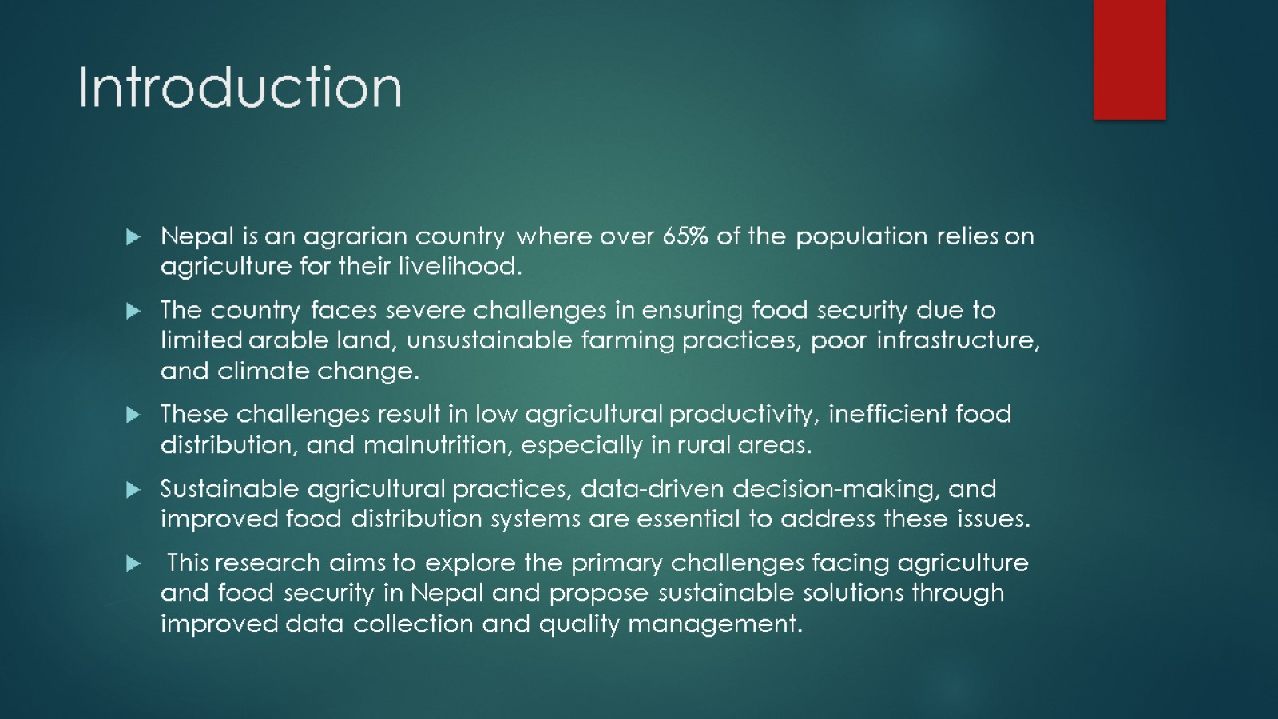
Introduction

Slide 3
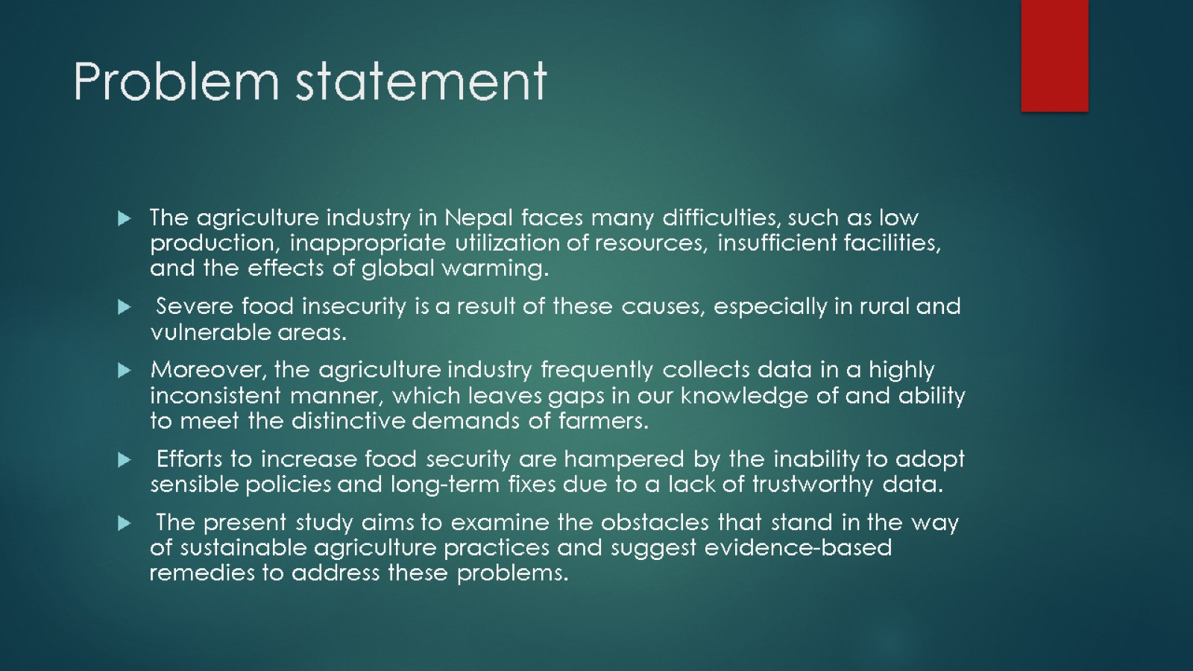
Problem statement

Slide 4

Amis

Slide 5
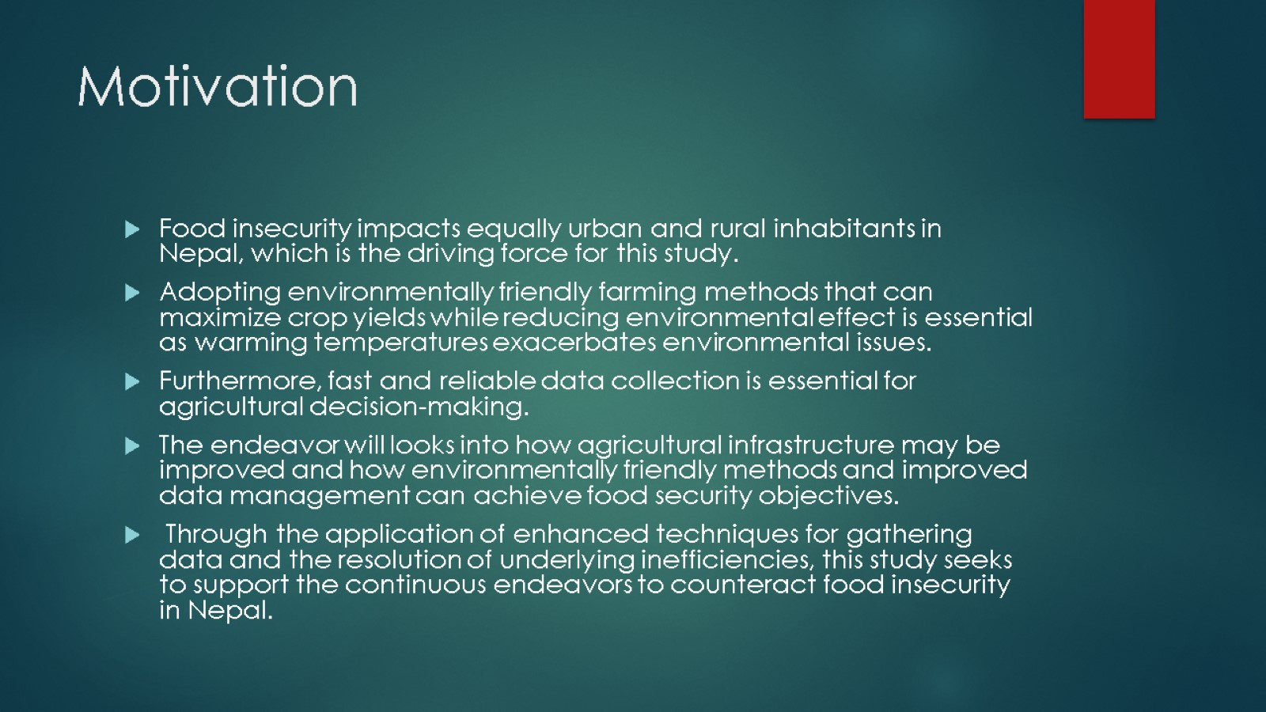
Motivation

Slide 6
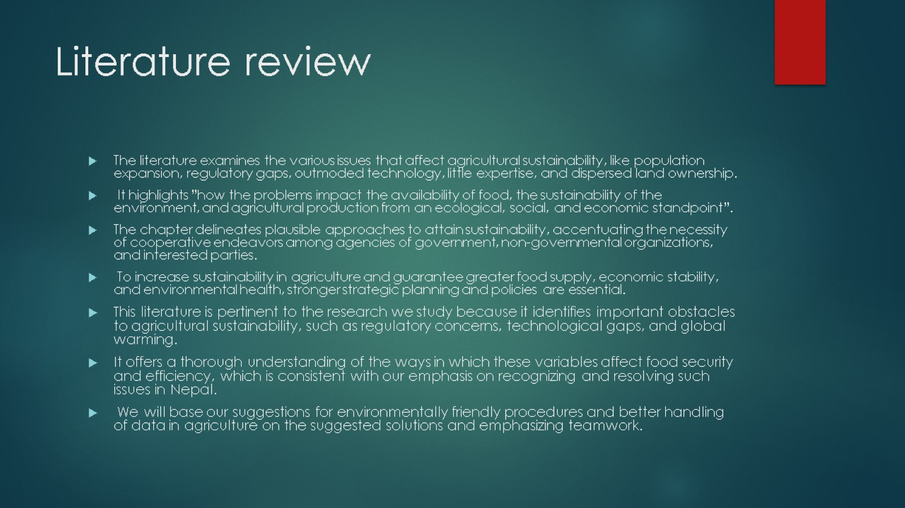
Literature review

Slide 7
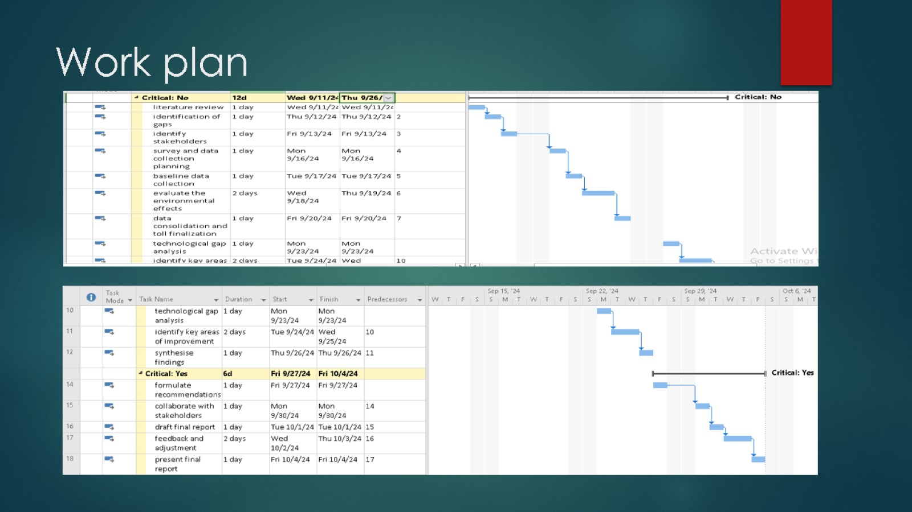
Work plan

Slide 8

Conclusion

